Slide 1
MOST COMMON
DEATH PENALTY METHODS
CURRENT WORLD ISSUES
MRS. TERPSTRA

Slide 2

THE WORLD’S VIEW

Slide 3
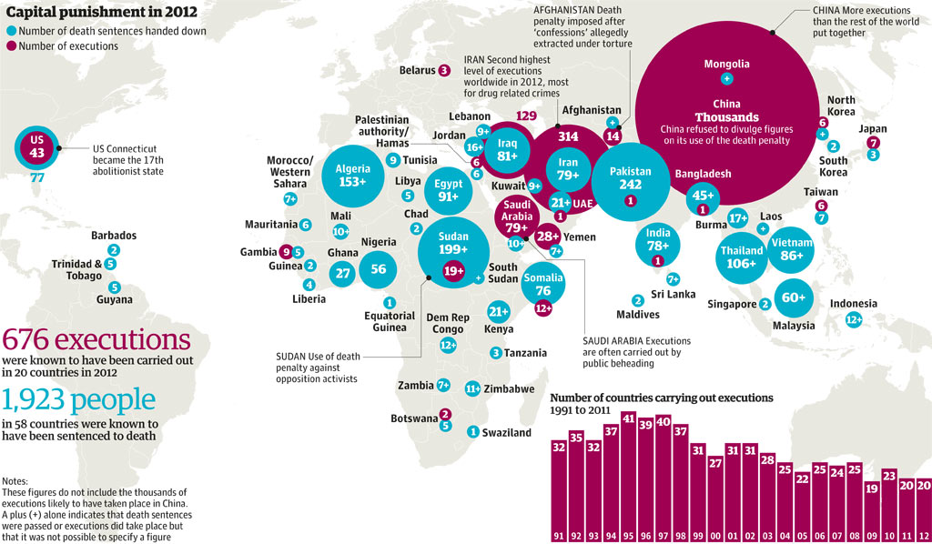
Trend?
What is the difference between colors?
How do we compare to the world?

Slide 4

Top 5 states?
States w/o Death Penalty?

Slide 5
7 METHODS TYPICALLY USED…
Hanging | Used in 78 Countries
Shooting | 86 Countries-mostly for war crimes or military court
Electrocution, poison gas, lethal injection | Used in U.S. alone-varies from state to state
Beheading by sword | Islamic law-used in 5 countries
Stoning | 7 countries for sexual crimes (but not all have been USED in last ten years)
Guillotine | Prescribed in Congo and Belgium but no longer used
3 Pushed off a cliff instead of being crushed to death or beheaded | Iran
 | Source: Amnesty International 1997

Slide 6
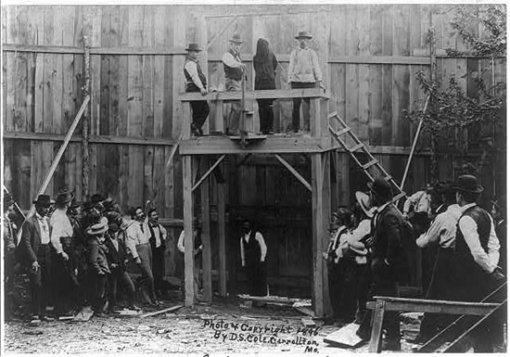
HANGING
Movie Nuremberg: Hanging Nazi War Criminals
Killed by force of the rope exerted against the body
Unconsciousness and death are brought on by damage to the spinal cord or, if that doesn’t work, then by suffocation by force cutting off the trachea
Trap door under feet
Length of rope varies
Distance of fall is calculated by prisoner’s weight/height
Goal: to sever the spinal cord without removing the head
Before this modern form, slow strangulation was used-today in Iran and Libya

Slide 7
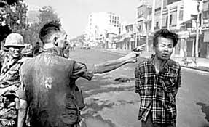
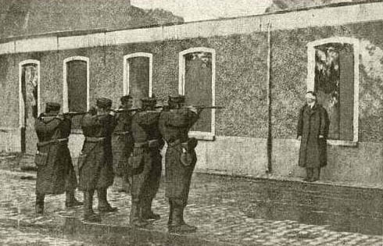
SHOOTING
Firing Squad video
Carried out either by single executioner or firing squad
Killed by one or combination of effects: damage to vital organs, central nervous system or bleeding out
Point blank method to the head is more immediate but target is smaller
Firing squad requires multiple executioners, death is slower even though target is bigger-the torso

Slide 8
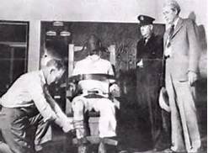
ELECTROCUTION
George Stinney-Youngest person executed in the 20th Century-14 years old
Introduced in U.S. in 1888 on grounds it would be more humane than hanging
Process: secure prisoner to chair, attach moistened copper electrodes to the head and leg (which have been shaved to ensure effective contact with skin)
Powerful surges of electric current are applied for brief periods
Death is caused by cardiac arrest and respiratory paralysis
Effects: internal organs are burned, prisoner often leaps forward against straps when the switch is thrown. May defecate or urinate or vomit blood. Eye-witnesses always report a smell of burned flesh.

Slide 9
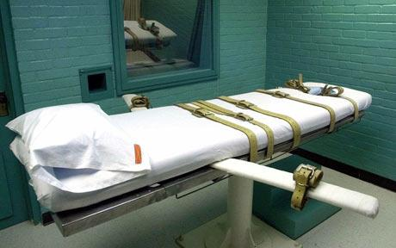
LETHAL INJECTION
Dead Man Walking
Involves a continuous I.V. injection of a short-acting barbiturate in combo with a chemical paralyzing agent
This is similar to general anesthesia but the drugs are injected in fatal amounts
(See next slide)
Some believe it’s more humane; others point to these problems: certain medical conditions make the body react differently to meds as well as scarred veins requiring cutting into veins
Introduced in Oklahoma and Texas in 1977.

Slide 10
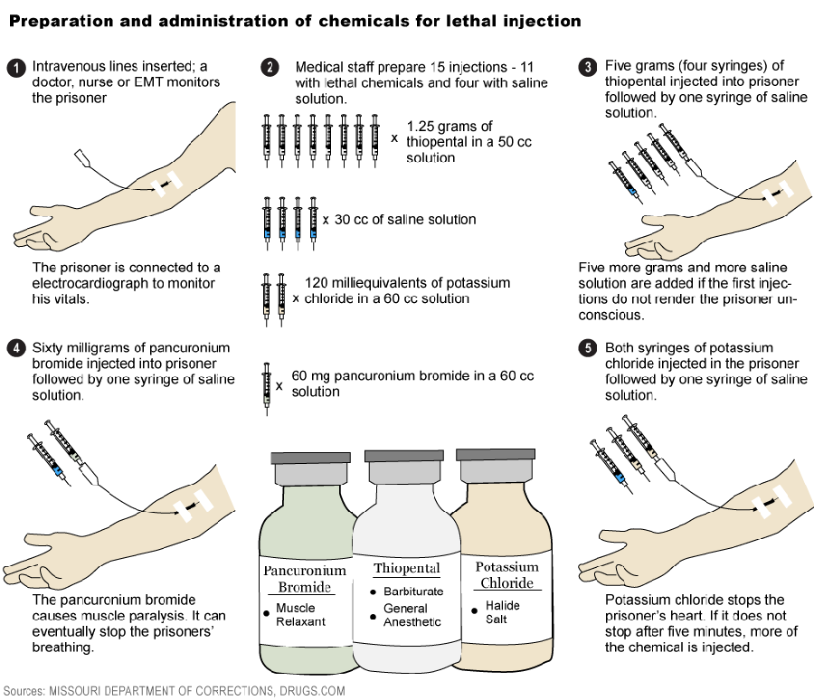
Paralyzes the diaphragm and stops the lungs
Makes prisoner unconscious
Stops the heart

Slide 11
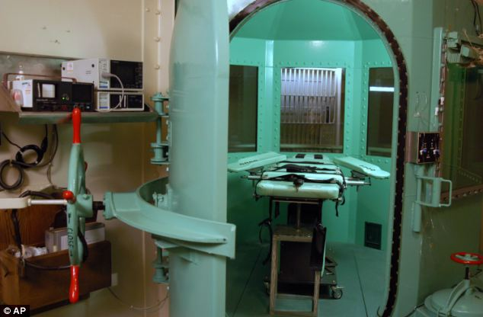
GASSING
Adding the Gas Chamber?
Prisoner is secured to a chair in an airtight chamber. A stethoscope is strapped to his or her chest which is connected to earpieces in the witness room so doctors can monitor the progress of the execution.
Cyanide gas is released in the chamber, poisoning the prisoner when they inhale.
Death is caused by asphyxiation
Although unconsciousness may follow rapidly, the process will take longer if the prisoner tries to hold their breath or breathe slowly
Even though the prisoner may be unconscious, their vital organs can continue to function for a short time.
For example, when Jimmy Lee Gray was executed on Sept. 2, 1983, he reportedly had convulsions for 8 minutes and gasped 11 times, striking his head repeatedly on a pole behind him. Witnesses were asked to leave the witness room at that point.

Slide 12
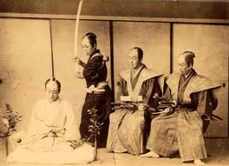
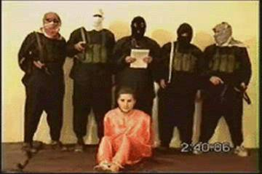
BEHEADING
In past Asian culture, beheading was reserved as an honorable, warriors way to die
The method used in Saudi Arabia, Qatar, Yemen and the United Arab Emirates includes severing the head from the body with a sword.
Death is caused by the sharp blade cutting quickly through the spinal cord, causing unconsciousness from spinal shock
Although it is intended that death comes quickly, several blows may be needed because the sword is a light tool and also depends on the strength and accuracy of the executioner.
May 11, 2004-Beheading of American civilian, Nick Berg, in Iraq by an Al-Qaida affiliated group to avenge the abuse of Iraqi prisoners by American soldiers.

Slide 13
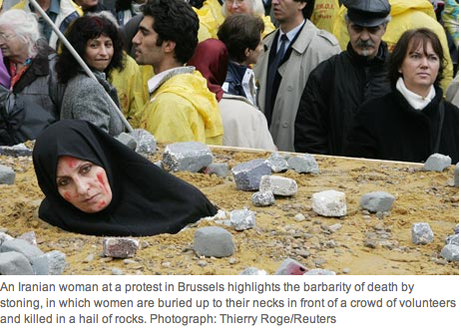
STONING
The Stoning of Soraya M.
The prisoner is buried to the neck or restrained
Death is caused by damage to the brain, asphyxiation, or a combination of injuries.
Because a person may sustain severe blows without losing consciousness, the death process can be very slow.
In Iran, one of 6 countries which prescribes stoning by law, it stipulates that death cannot come from one single blow.
“In the punishment of stoning to death, the stones should not be too large so that the person dies on being hit by one or two of them; they should not be so small either that they could not be defined as stones.” Article 119 Islamic Penal Code of Iran
An eye-witness to a stoning reported,
“The Lorry deposited a large number of stones and pebbles beside the waste ground, and then two women were led to the spot wearing white and with sacks over their heads…they were enveloped in a shower of stones and transformed into two red sacks…The wounded women fell to the ground and Revolutionary Guards smashed their heads in with a shovel to make sure they were dead.”

Slide 14
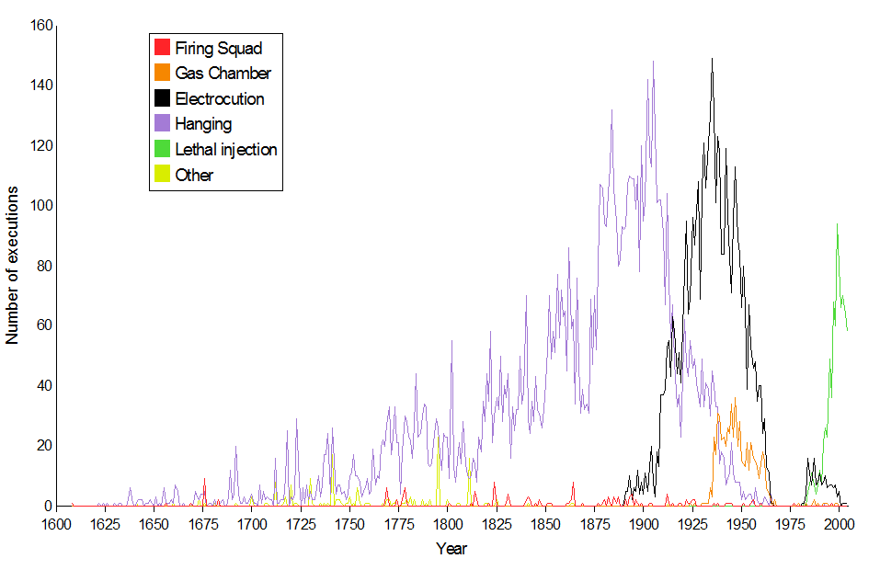
METHODS USED IN THE UNITED STATES
What are the top 3 methods used in our history?
What methods are used today?
What method has continued throughout our history?

Slide 15
SELF-ASSESSMENT:
How do you feel about the death penalty?
Which methods are ok or not ok to you?
Could YOU pull the switch or inject the prisoner yourself?
If your answer is no, is it ok to ask someone else to do something you could not do?

Slide 16
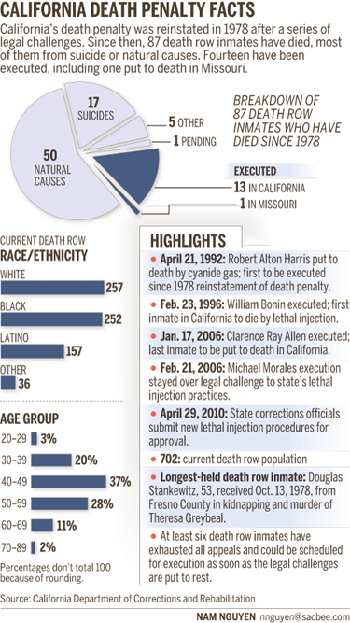
STATS
What surprises you about these facts?
Why might victim’s families be upset with these statistics?

Slide 17
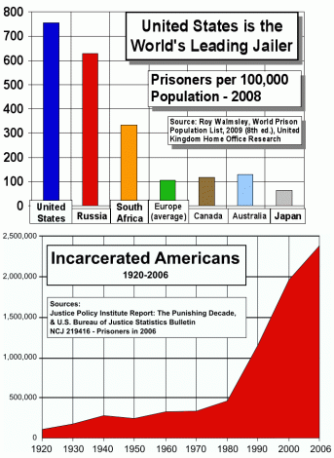
STATS
How do we compare to the world?
Has criminal activity increased, decreased or stayed the same in history?

Slide 18
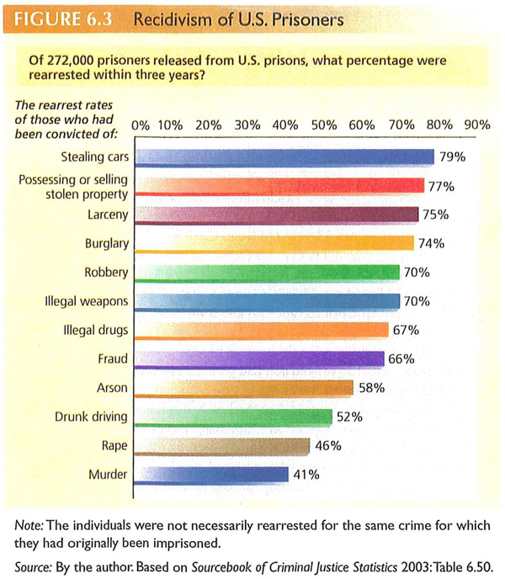
RECIDIVISM
Definition: When a criminal relapses into criminal behavior after serving their sentence.
Does prison teach our criminals to stop breaking the law? Why?
What might encourage prisoners to recidivate?
Why are violent crimes lower than violent crimes in recidivism?

